Slide 1
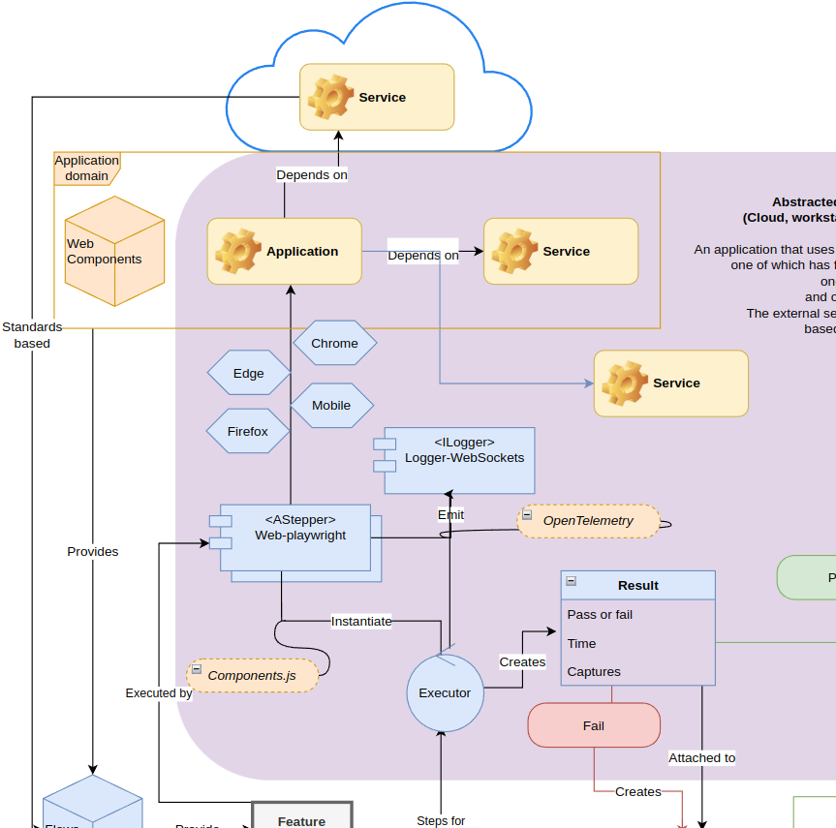
Haibun End to end test driven development in abstracted environments
Dashboard August 4, 2023
Overview diagram

Slide 2
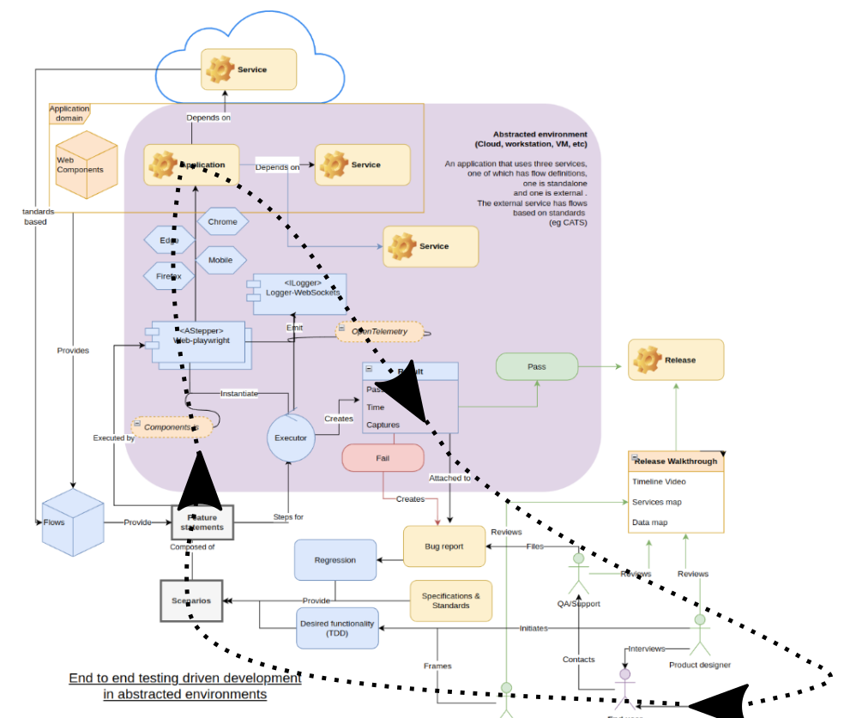
Workflow

Slide 3
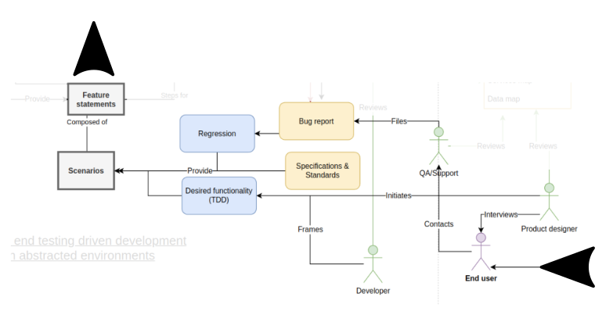
Phases: Dev & support

Slide 4
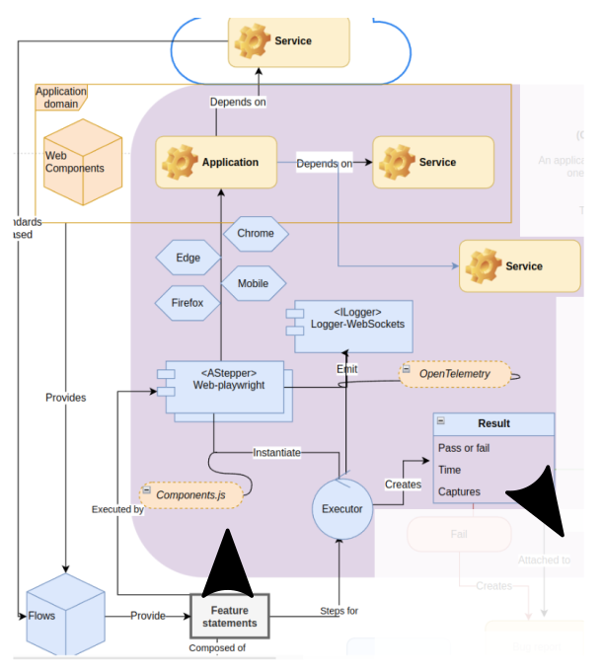
Phases: Evaluation

Slide 5
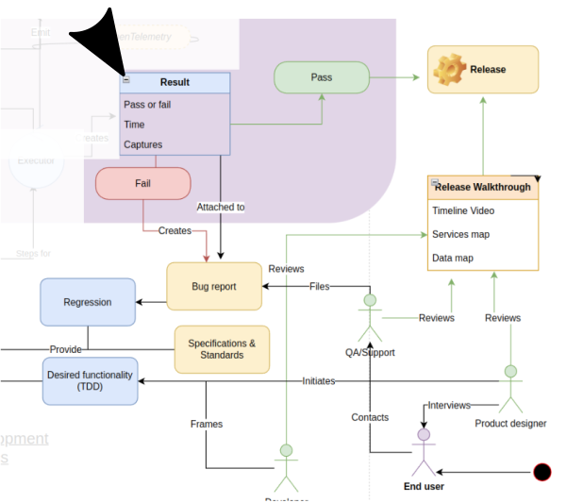
Current dev
Streamlining (ongoing)
Improve DX
Informative guidance & errors
Run locally (fast) or in cloud on commit
Dashboard integration (99.889%)
Axe accessibility (Adi)
Fix problems before they’re noticed
Research
Using standards
Scaling load tests

Slide 6
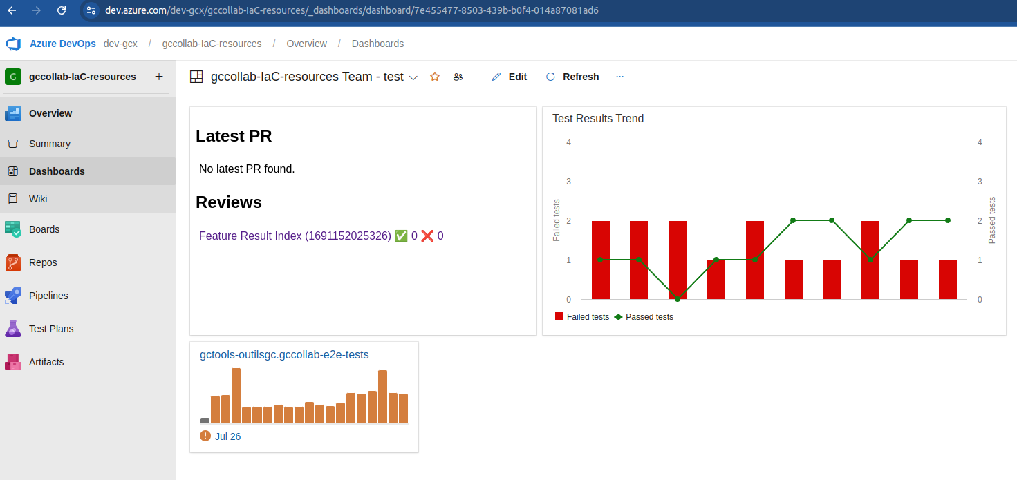
Comprehensive dashboard
https://dev.azure.com/dev-gcx/gccollab-IaC-resources/_dashboards/dashboard/7e455477-8503-439b-b0f4-014a87081ad6

Slide 7
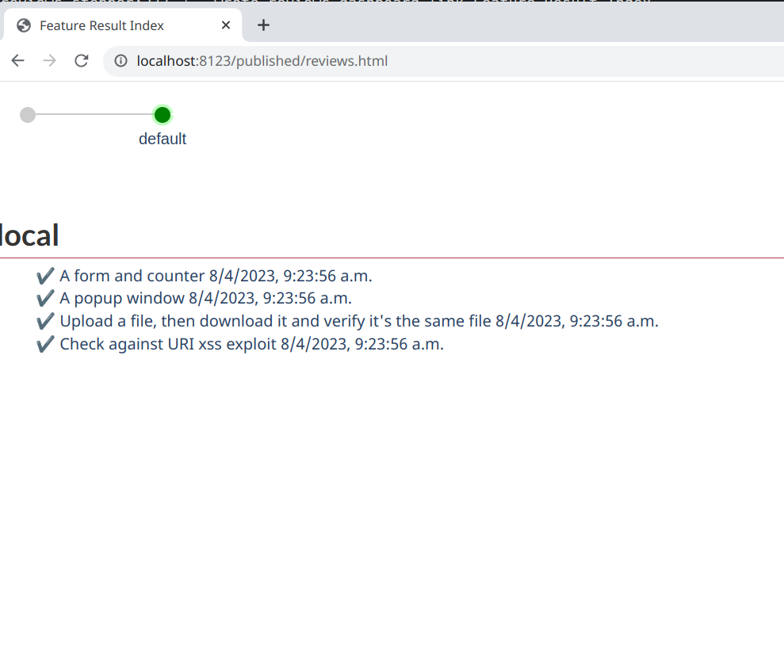
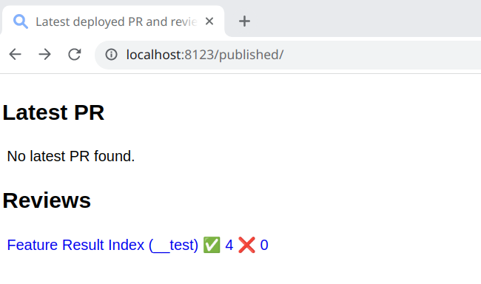
Post .111% experience

Slide 8
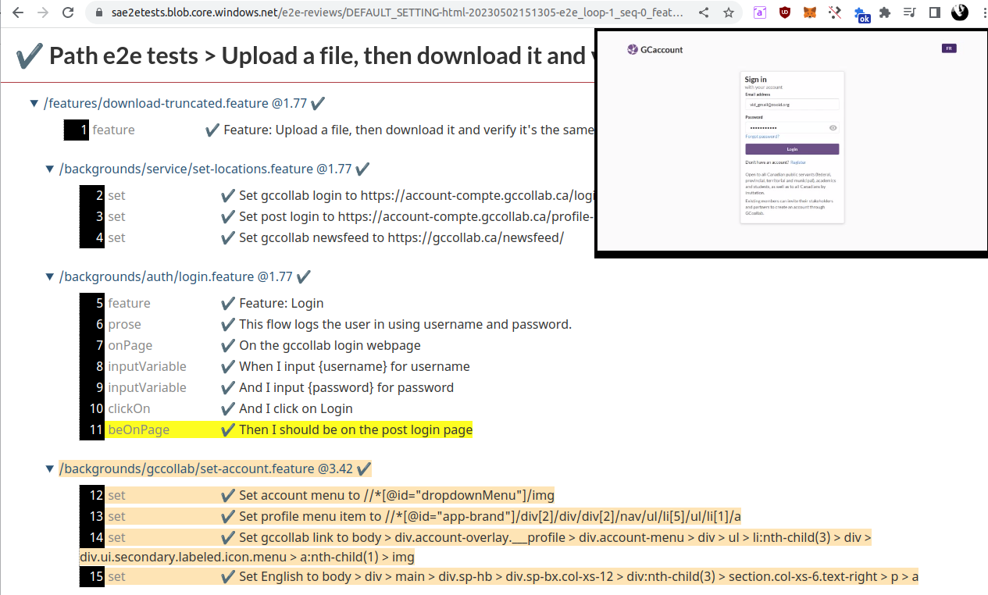
These comprehensive reviews are created per commit, can be set with expiry for releases, etc

Slide 9
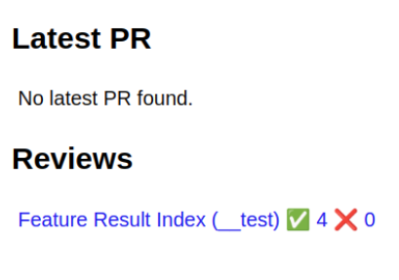
Next steps (August)
Apply to pipelines
Already used for legacy gccollab
Post link for current live PR

Slide 10
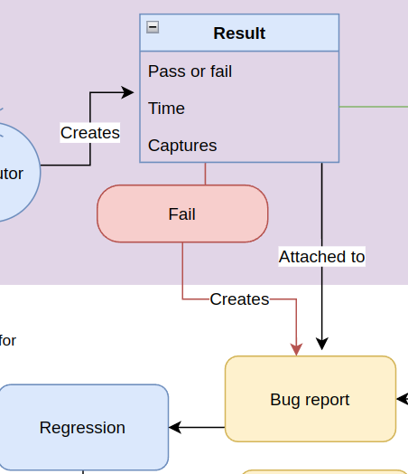
Next steps (August)
Create issue on failure (functional, accessibility, etc)
Link to review
Assign to person
Easier failure specifics in bug report/reviews

Slide 11
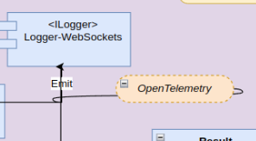
Next steps (August)
Streamlining
Simplify main workflow
Run tests per stepper type (Check web accessibility after every web action)
Load testing
horizontal scaling
reporting
OpenTelemetry?

Slide 12
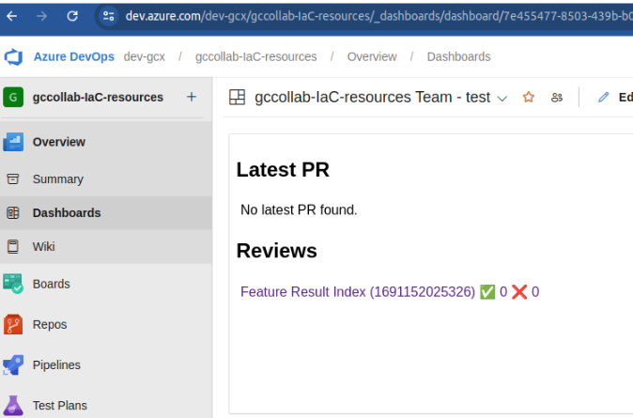
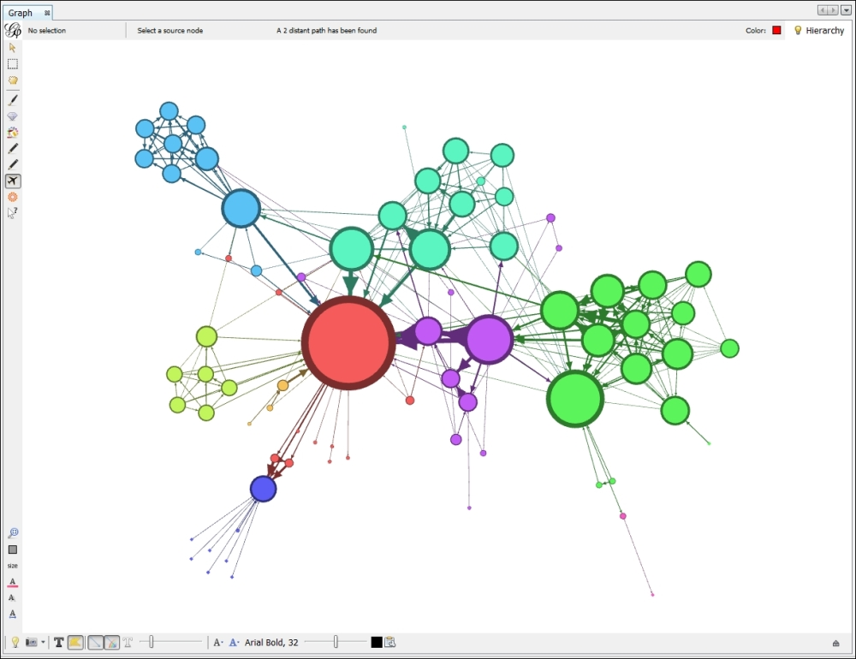
Ideas to build on the dashboard
Use it as a base
Map with scalability
AI suggestions/support
…
Anything else that builds on
the fidelity / workflow / environment

